Slide 1
Meeting #6
Genome assembly (applications)
Genome annotation
Alignment

Slide 2
Genome annotation
Finding genes in an unknown DNA sequence

Slide 3
Annotating regions in a DNA sequence
Protein coding gene
Non coding RNA gene
Repeat elements
Regulatory regions
Based on previous knowledge
Homology (similar sequences between different organisms)
Similarity to known genes
Ab initio (from scratch)
For protein coding genes: Rule based - start (commonly ATG) and stop codons(TAA/TAG/TGA) and some nucleotide context around them, splice sites, etc. Should check in 6 frames
For all genes: Statistical information (based on a priori training). E.g. codon bias (for protein coding genes), nucleotide composition

Slide 4
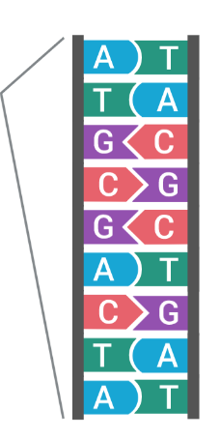
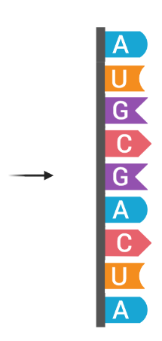
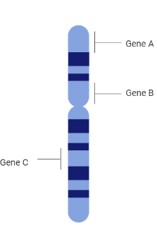
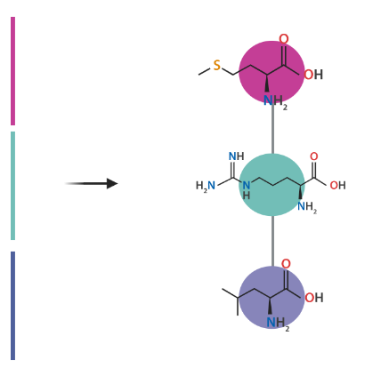
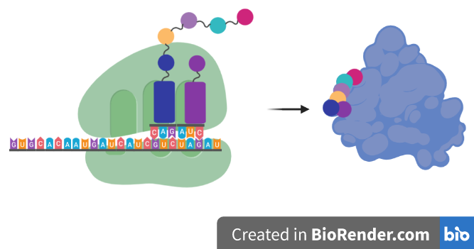
How protein coding genes work (reminder)
Amino acid (Met)
Codon (AUG)
Proteins are chains of monomers called amino acids.
There are 20 different types of amino acids.
During protein synthesis (translation), every triplet of nucleotides (codon) on mRNA are converted into amino acids. There is many to one mapping of codons to amino acids.
Codon (CUA)
Amino acid (Leu)
IGV image of stop codons

Slide 5
Protein synthesis
Start
ATG
Note: RNA contain U instead of T, but in bioinformatics applications you will often notice that T is used to represent U in RNA for simplicity.
Stop
TAA
TGA
TAG
ATG
CTA
GGA
GTA
ATC
AGC
ACG
GGT
ACG
GGT
AGG
GGT
TAA
ORF1
A
TGC
TAG
GAG
TAA
TCA
GCA
CGG
GTA
CGG
GTA
GGG
GTT
AA
ORF2
AT
GCT
AGG
AGT
AAT
CAG
CAC
GGG
TAC
GGG
TAG
GGG
TTA
A
ORF3
Open reading frame (ORF)
Translating RNA into Protein
http://rosalind.info/problems/prot/

Slide 6
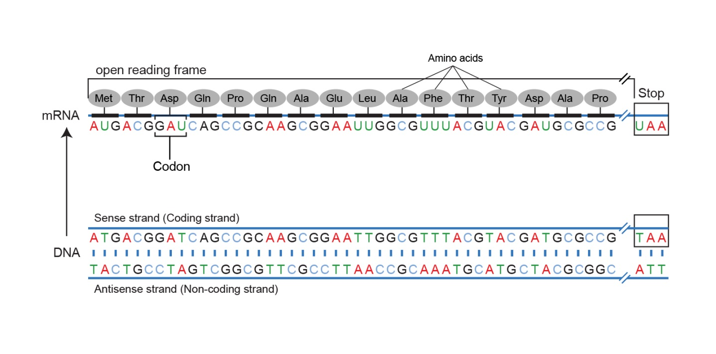
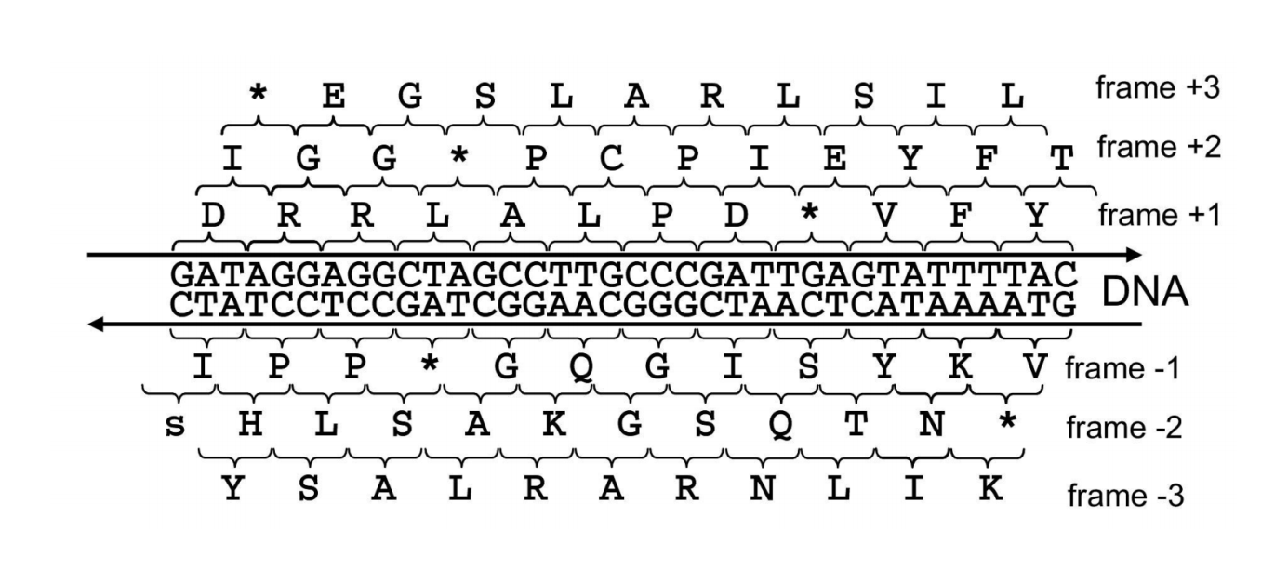
Advanced problems
Open reading frames (ORF)
Either strand of a DNA double helix can serve as the coding strand for RNA transcription. Hence, a given DNA string implies six total reading frames, or ways in which the same region of DNA can be translated into amino acids: three reading frames result from reading the string itself, whereas three more result from reading its reverse complement. An open reading frame (ORF) is one which starts from the start codon and ends by stop codon, without any other stop codons in between. Thus, a candidate protein string is derived by translating an open reading frame into amino acids until a stop codon is reached.)
The standard genetic code:
http://www.bioinformatics.org/JaMBW/2/3/TranslationTables.html#SG1
Finding Genes with ORFs
http://rosalind.info/problems/orfr/
Open Reading Frames
http://rosalind.info/problems/orf/
Protein Translation
http://rosalind.info/problems/orf/
IGV image of stop codons

Slide 7
Annotating regions in a DNA sequence
Protein coding gene
Non coding RNA gene
Repeat elements
Regulatory regions
Based on previous knowledge
Homology (similar sequences between different organisms)
Similarity to known genes
Ab initio (from scratch)
For protein coding genes: Rule based - start (commonly ATG) and stop codons(TAA/TAG/TGA) and some nucleotide context around them, splice sites, etc. Should check in 6 frames
For all genes: Statistical information (based on a priori training). E.g. codon bias (for protein coding genes), nucleotide composition

Slide 8
Genome alignment/mapping
Illustrations taken from the course Algorithms for DNA Sequencing (Johns Hopkins University)
https://www.coursera.org/learn/dna-sequencing/home

Slide 9
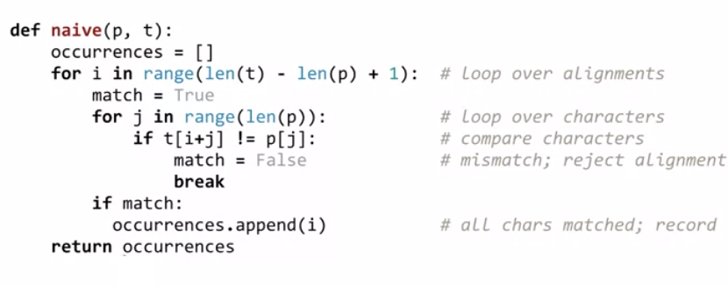
Exact matching: naïve algorithm
GTAATGTGT
CCGTAATGTCGTAATGTGTAATGTCAGGTAATGTGTAATGTGACCTCGTAATGTGTCCTCGCCGTAATGTTGTAATGTGTAATGTGTGTGCGATGTGACGGTAATGTCTGTAATGTCTGCGTAATGTGTAATGTGCGTAATGTG
GTAATGTGT
GTAATGTGT
GTAATGTGT
GTAATGTGT
GTAATGTGT
CCGTAATGTCGTAATGTGTAATGTCAGGTAATGTGTAATGTGACCTCGTAATGTGTCCTCGCCGTAATGTTGTAATGTGTAATGTGTGTGCGATGTGACGGTAATGTCTGTAATGTCTGCGTAATGTGTAATGTGCGTAATGTG
Iterate over alignments in the left-to-right order,
compare charachters within each alignment in the left-to-right order.
Finding a motif in DNA
http://rosalind.info/problems/subs/

Slide 10
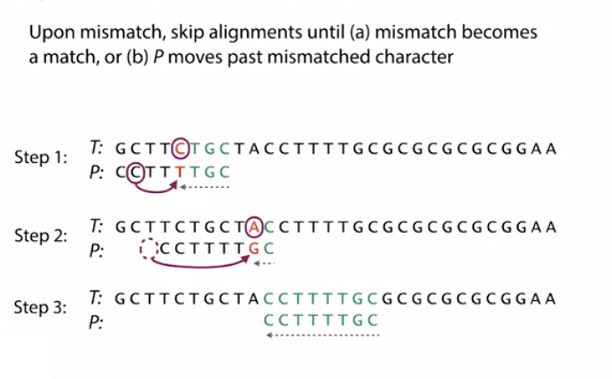
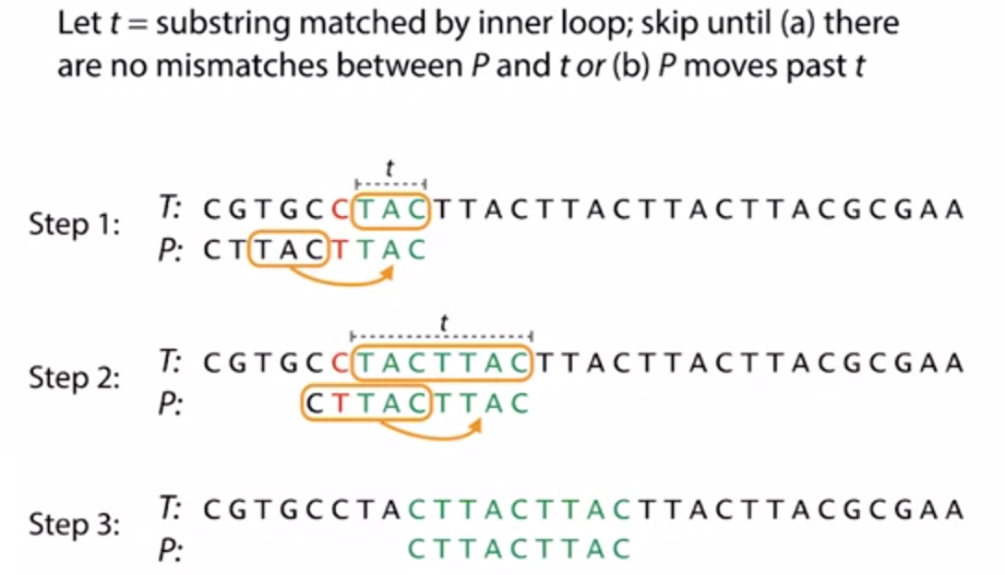
Exact matching: Boyer-Moore Skip pointless alignments!
Iterate over alignments in the left-to-right order,
compare charachters within each alignment in the right-to-left order.
Bad character rule
Good suffix rule

Slide 11
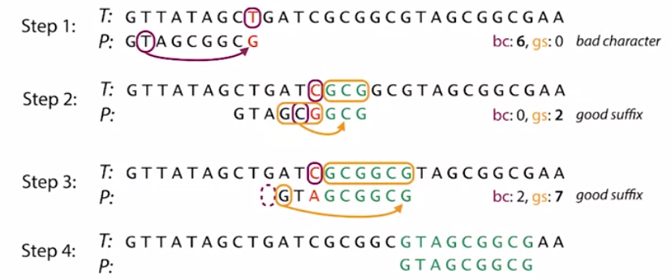
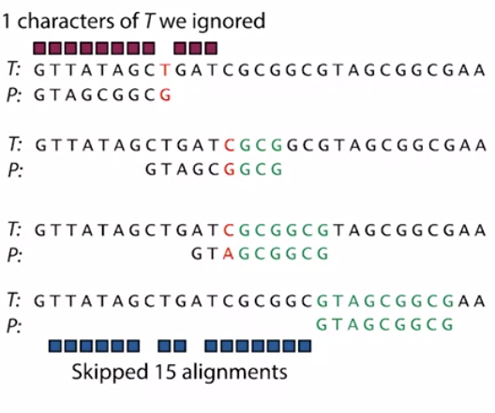
Using the two Boyer-Moore rules together.
Shift by the maximum number of alignments provided by the two rules!
How many alignments and comparisons did we skip?

Slide 12
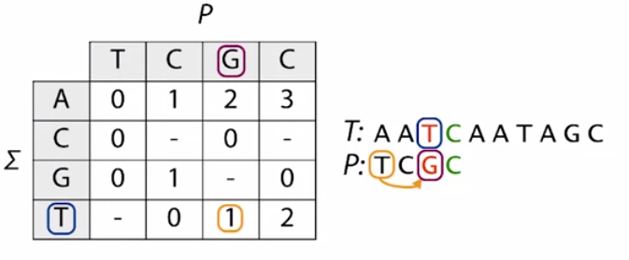
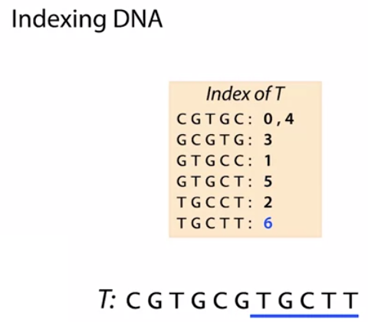
Eyebolling is not enough! Preprocessing
Should we preprocess the pattern or the text?

Slide 13
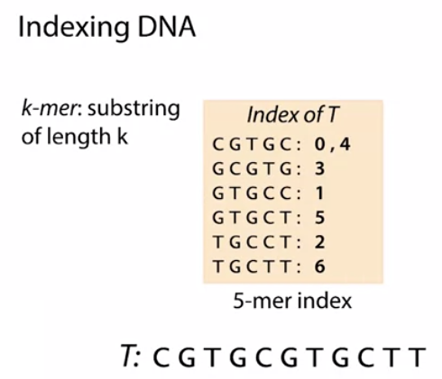
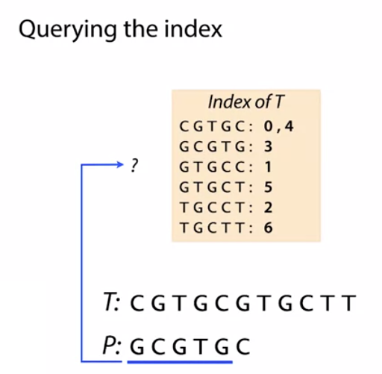
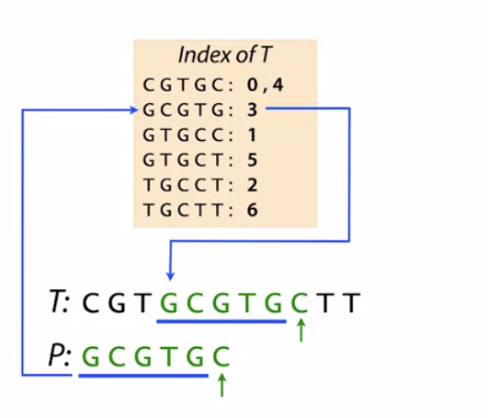
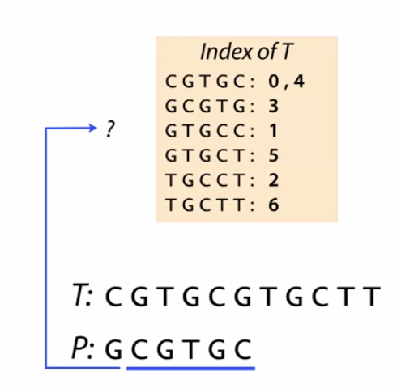
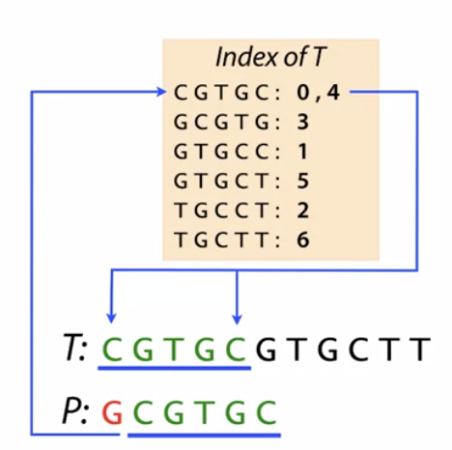
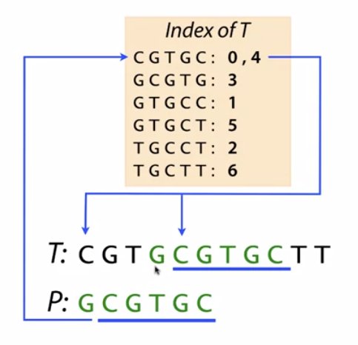
Querying the DNA index

Slide 14
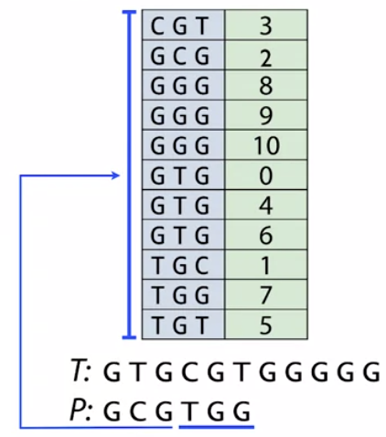
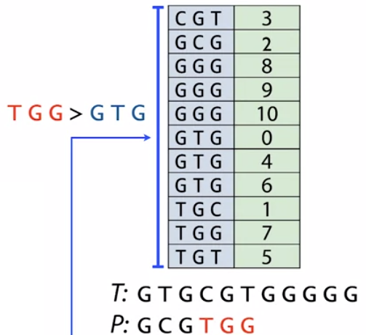
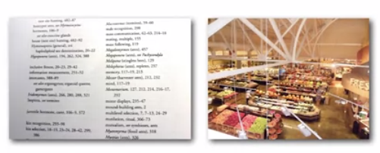
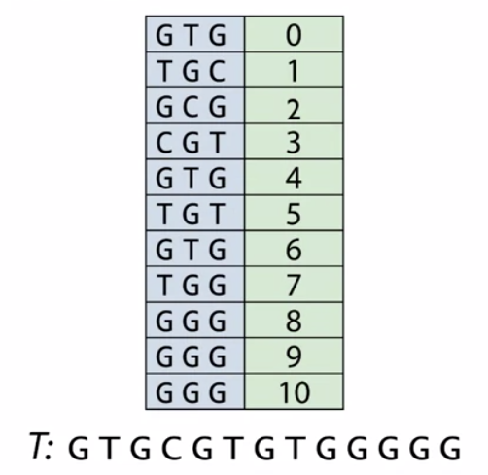
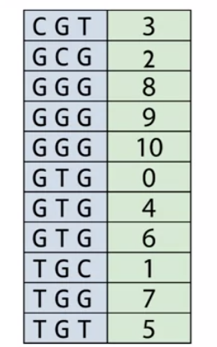
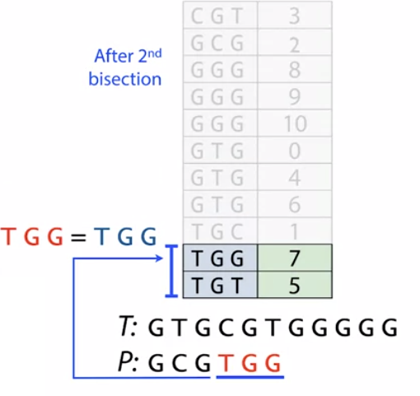
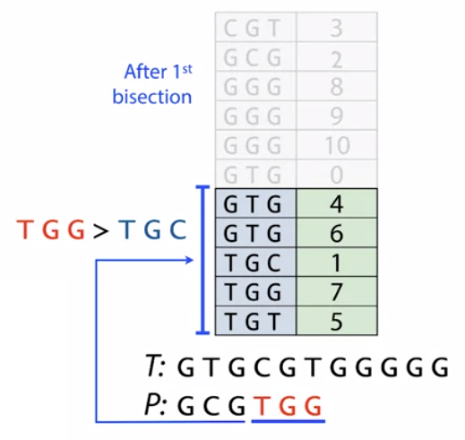
Ordered structures for indexing
Use binary search to query
ordering
grouping
Order

Slide 15
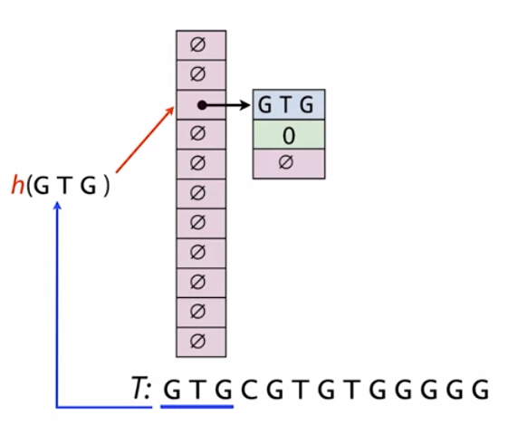
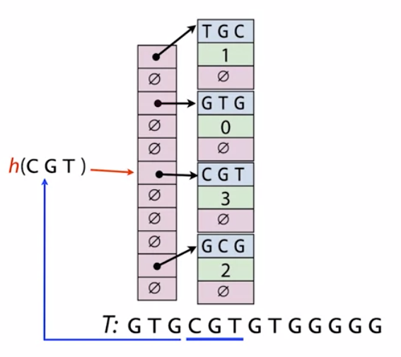
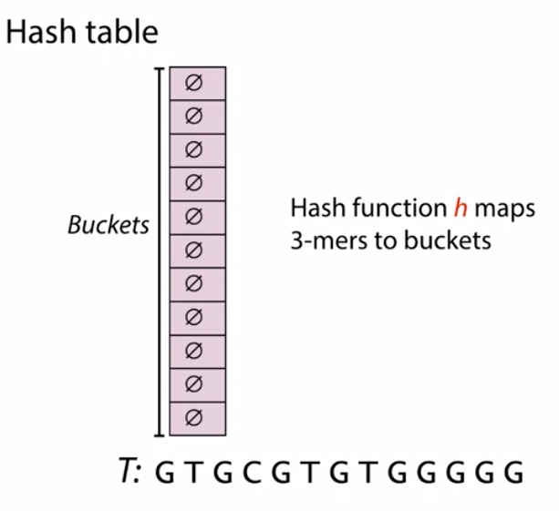
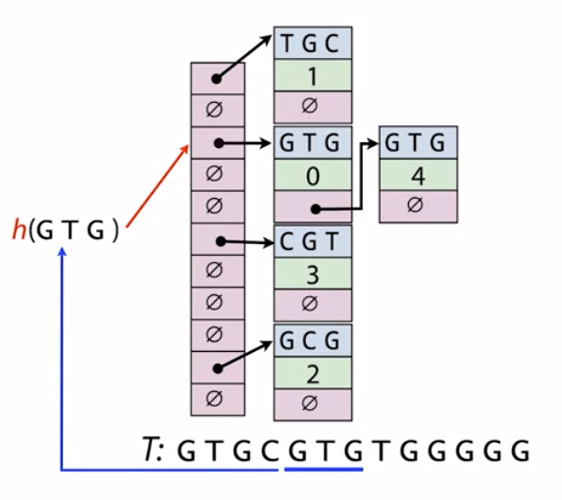
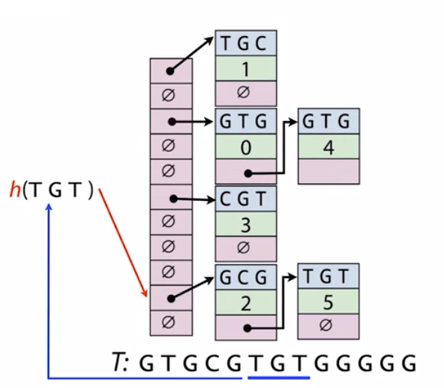
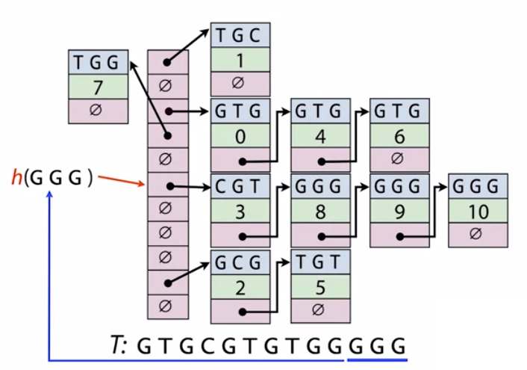
Hash tables
We don’t discuss how for now.
Collisions

Slide 16
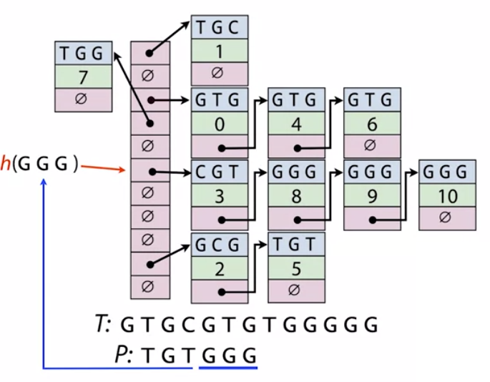
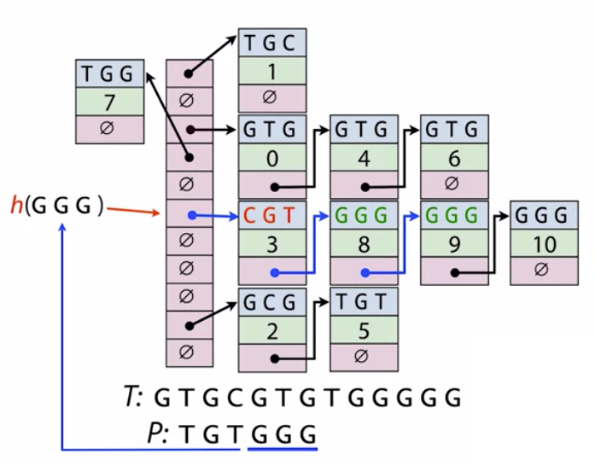
Querying hash tables
Use the hash function to assign the k-mer to the bucket

Slide 17
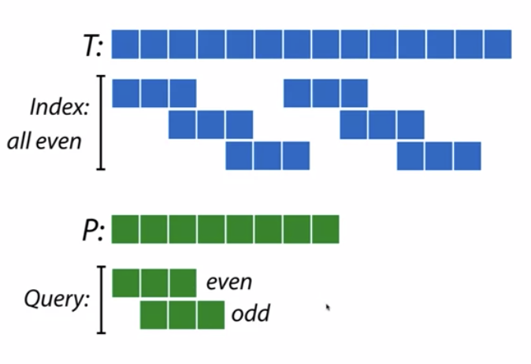
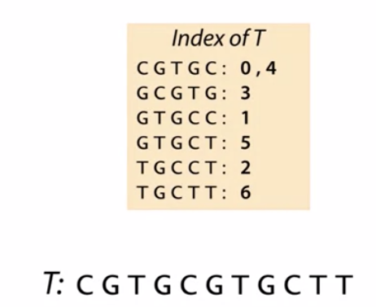
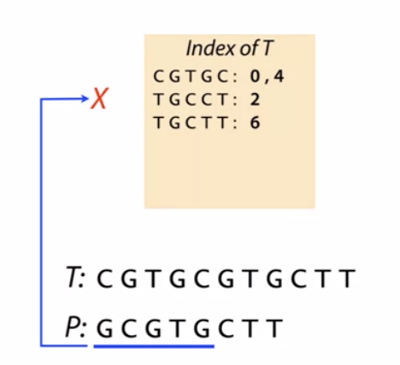
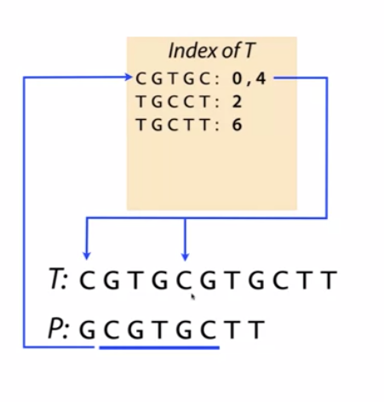
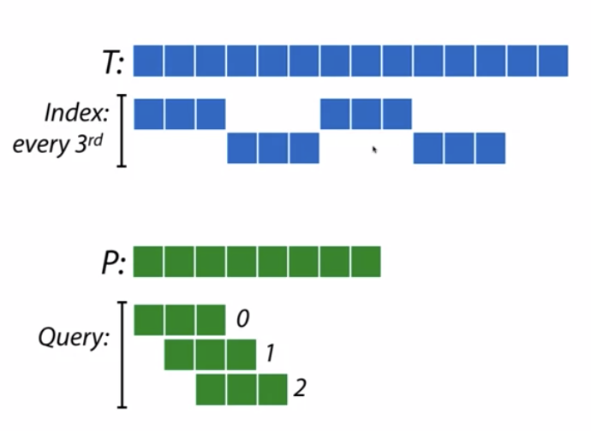
Variations on k-mer indexes
Take only the even offset k-mers
Take every third (nth) offset k-mer

Slide 18
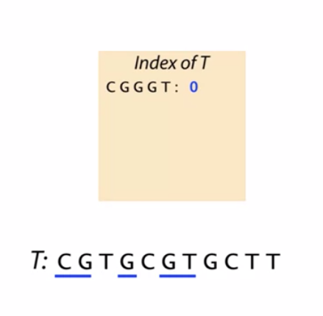
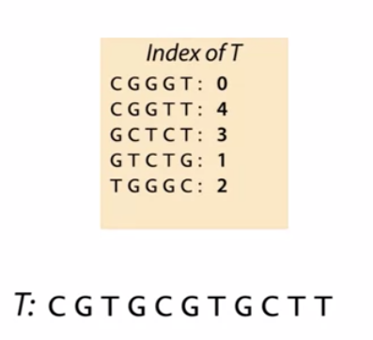
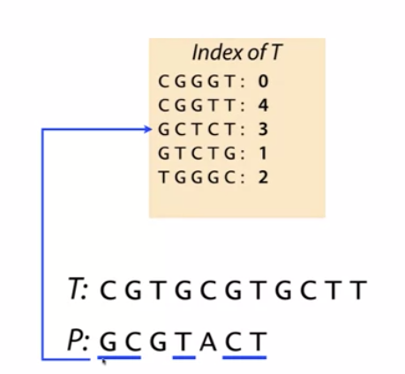
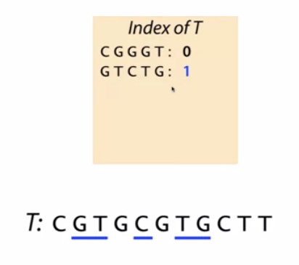
More variations: subsequences
Subsequences
A subsequence of S is a string of characters also occuring in S in the same order. Not necessarily consecutive.

Slide 19
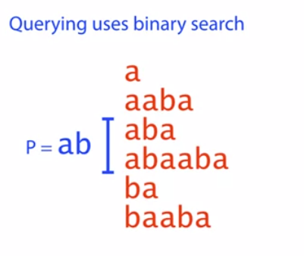
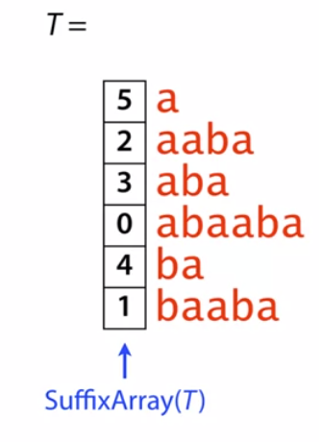
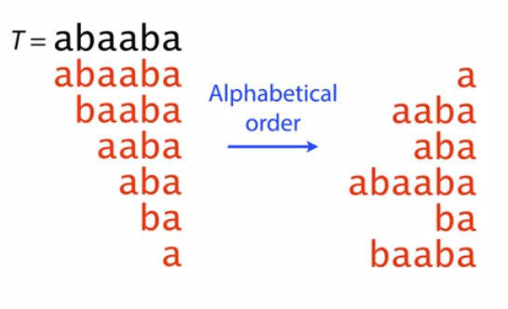
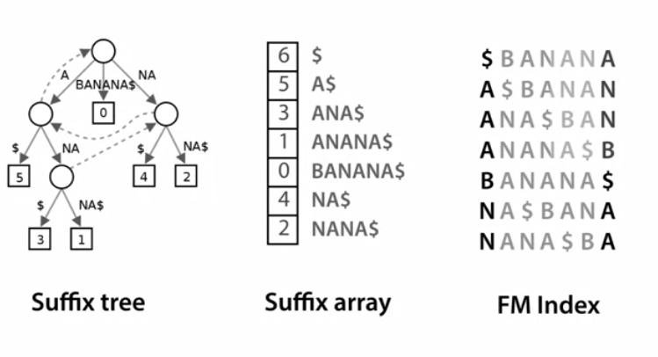
More variations: suffix indexes
The large genome problem
Instead of storing the suffixes, we can only store the offset.
Grouping
Ordering
Burrows-Wheeler transform (used by Bowtie, BWA, etc.)

Slide 20
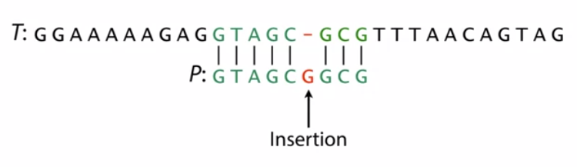
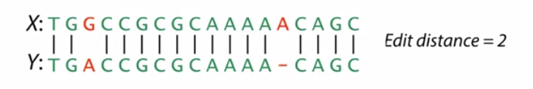


Exact versus approximate matching
- Sequencing errors
- Natural variation
Hamming distance (dissimilarity score)
The number of non-matching bases
How to implement approximate matching for the Hamming distance?
Edit distance
The number of edit operations (substitutions, deletions, insertions) needed to turn one sequence into the other.

Slide 21







Approximate matching implementation: Pigeonhole principle
Because ...
Pigeonhole principle
if you have ten pigeons and nine pigeonholes then at least one pigeonhole will have more than one pigeon in it.
In our case, if you have 8 pigeons, at least one Pigeonhole is going to be empty

Slide 22


Global and local alginments
Aligns two sequences head to tail.
Penalty matrix
Start from the minimum
Global alignment may be solved with dynamic programming algorithms implementing penalty matrices

Slide 23



Global and local alignments
Start from the maximum

Slide 24

Putting it all together
Indexing helps locate the offsets in the genome, where sequence comparison can be performed with dynamic programming. This is important, as performing dynamic programming on the whole genome would be not feasible.

Slide 25
Big papers in alignment
Basic local alignment search tool
59895 citations
Altschul SF, Gish W, Miller W, Myers EW, Lipman DJ. Basic local alignment search tool. J Mol Biol. 1990;215(3):403-410. doi:10.1016/S0022-2836(05)80360-2
The BLAST website: https://blast.ncbi.nlm.nih.gov/Blast.cgi
Bowtie
26444 citations
Heng Li, Richard Durbin, Fast and accurate short read alignment with Burrows–Wheeler transform, Bioinformatics, Volume 25, Issue 14, 15 July 2009, Pages 1754–1760, https://doi.org/10.1093/bioinformatics/btp324
What is the most cited paper?
https://www.nature.com/news/the-top-100-papers-1.16224

Slide 26
Thank you
Next topics:
Alignment
variant calling

